Slide 1
6.852: Distributed Algorithms Fall, 2015
Lecture 10

Slide 2
Today’s plan
I/O Automata, cont’d
Asynchronous network model
Asynchronous network algorithms:
Leader election
Constructing a spanning tree
Readings:
Chapter 8
Chapter 14
Section 15.1-15.3
Next:
Breadth-first search
Shortest paths
Minimum spanning trees
Readings:
Section 15.3-15.5
[Gallager, Humblet, Spira]

Slide 3
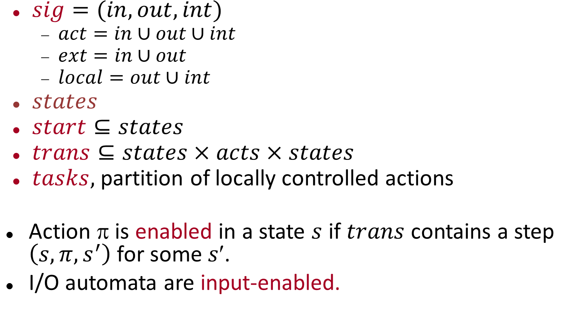
Input/Output automaton
$sig=(in,out,int)$
$act=in∪out∪int$
$ext=in∪out$
$local=out∪int$
$states$
$start⊆states$
$trans⊆states×acts×states$
$tasks,$ partition of locally controlled actions
Action $$ is enabled in a state $s$ if $trans$ contains a step $\left(s,π,s^{′}\right)$for some $s$.
I/O automata are input-enabled.

Slide 4
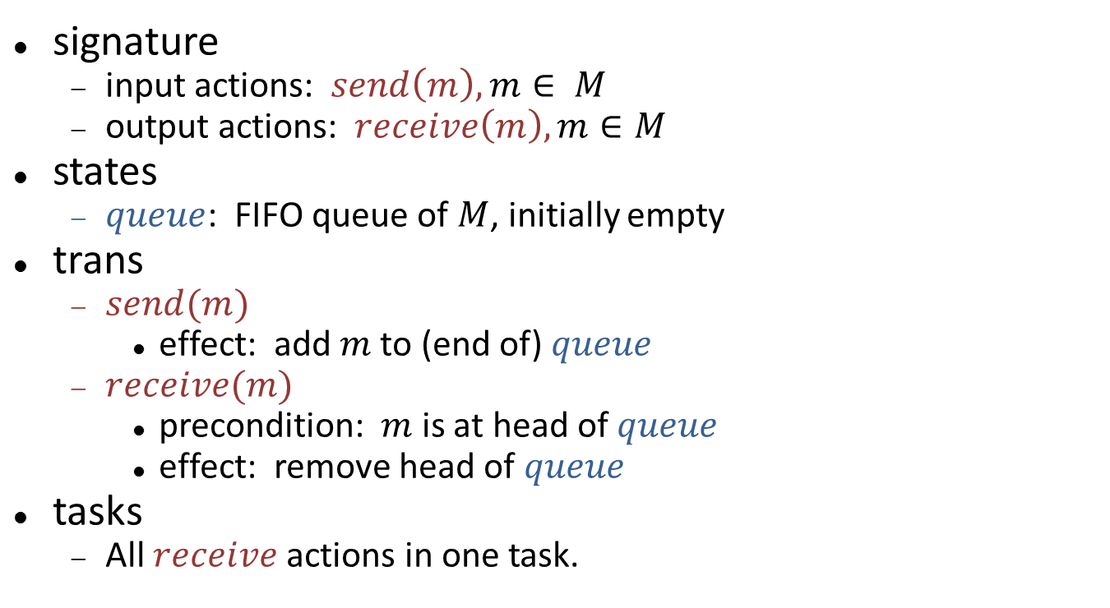
Channel automaton
send(m)
receive(m)
C
signature
input actions: $send\left(m\right), m∈ M$
output actions: $receive\left(m\right), m∈M$
states
$queue$: FIFO queue of $M$, initially empty
trans
$send(m)$
effect: add $m$ to (end of) $queue$
$receive(m)$
precondition: $m$ is at head of $queue$
effect: remove head of $queue$
tasks
All $receive$ actions in one task.

Slide 5
Executions
An execution of an I/O automaton is a finite or infinite sequence:
s₀ π₁ s₁ π₂ s₂ π₃ s₃ π₄ s₄ π₅ s₅ ... (if finite, ends in state)
s₀ is a start state
(s_{i}, π_{i+1}, s_{i+1}) is a step (i.e., in trans)
Execution fragment: Same, but might not begin in a start state.
The trace of an execution is the subsequence of external actions in the execution.
A trace of an I/O automaton is the trace of any execution of the automaton.

Slide 6
Properties and Proof Methods
Compositional reasoning
Invariants
Trace properties
Simulation relations

Slide 7
Compositional reasoning
Use Theorems 1-6 (projection, pasting, substitutivity) to infer properties of a system from properties of its components.
And vice versa.

Slide 8
Invariants
A state is reachable if it appears in some execution (or, at the end of some finite execution).
An invariant is a predicate that is true for every reachable state.
Most important tool for proving properties of concurrent and distributed algorithms.
Proving invariants:
Typically, by induction on length of execution.
Often prove batches of interdependent invariants together.
Step granularity is finer than round granularity, so proofs are more complicated and detailed than those for synchronous algorithms.

Slide 9
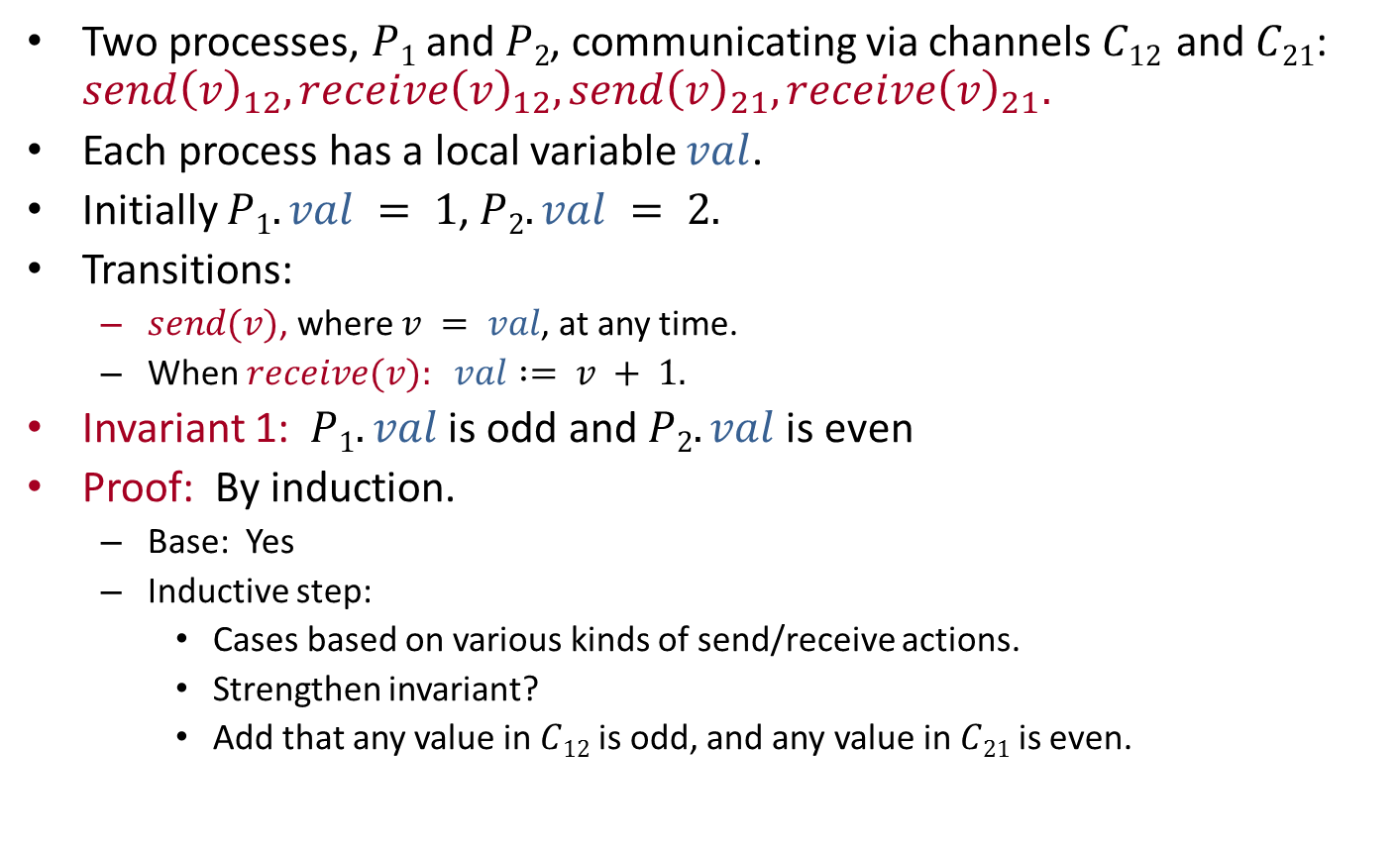
Example: Incrementing
Two processes, $P1$ and $P2$, communicating via channels $C12$ and $C21$: $send{\left(v\right)}_{12}, receive{\left(v\right)}_{12}, send{\left(v\right)}_{21}, receive{\left(v\right)}_{21}.$
Each process has a local variable $val$.
Initially $P1.val = 1$, $P2.val = 2.$
Transitions:
$send(v)$, where $v = val$, at any time.
When $receive(v): val := v + 1.$
Invariant 1: $P1.val$is odd and $P2.val$ is even
Proof: By induction.
Base: Yes
Inductive step:
Cases based on various kinds of send/receive actions.
Strengthen invariant?
Add that any value in $C12$ is odd, and any value in $C21$ is even.
Notes:
Go over cases in proof of Invariant 1:
Send preserves channel parity condition (based on process parity condition), without affecting process parity condition.
Receive preserves process parity condition (based on channel parity condition), without affecting channel parity condition.

Slide 10
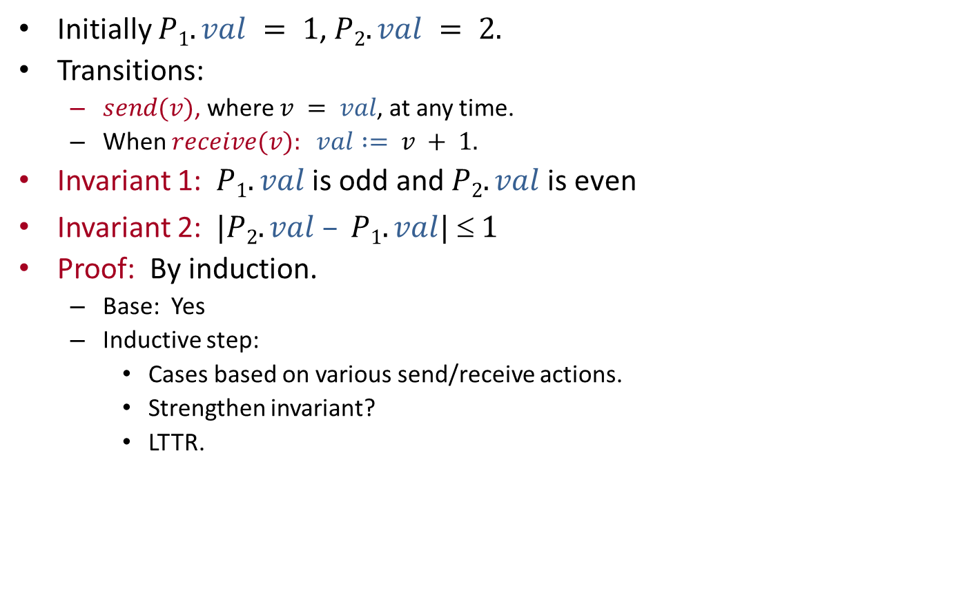
Example: Incrementing
Initially $P1.val = 1$, $P2.val = 2.$
Transitions:
$send(v)$, where $v = val$, at any time.
When $receive(v): val := v + 1.$
Invariant 1: $P1.val$is odd and $P2.val$ is even
Invariant 2: $|P2.val – P1.val|  1$
Proof: By induction.
Base: Yes
Inductive step:
Cases based on various send/receive actions.
Strengthen invariant?
LTTR.
Notes:
Invariant 2 can be strengthened, e.g.:
Either p1.val = p2.val + 1 or vice versa.
In the former case, C12 contains just p2.val – 1 = p1.val -2 and p2.val+1 = p1.val, in order, and C21 contains just p2.val.
In the latter case, C21 contains just p1.val – 1 = p2.val -2 and p1.val+1 = p2.val, in order, and C12 contains just p1.val.
Cases: send by smaller, send by larger, receive by smaller, receive by larger.

Slide 11
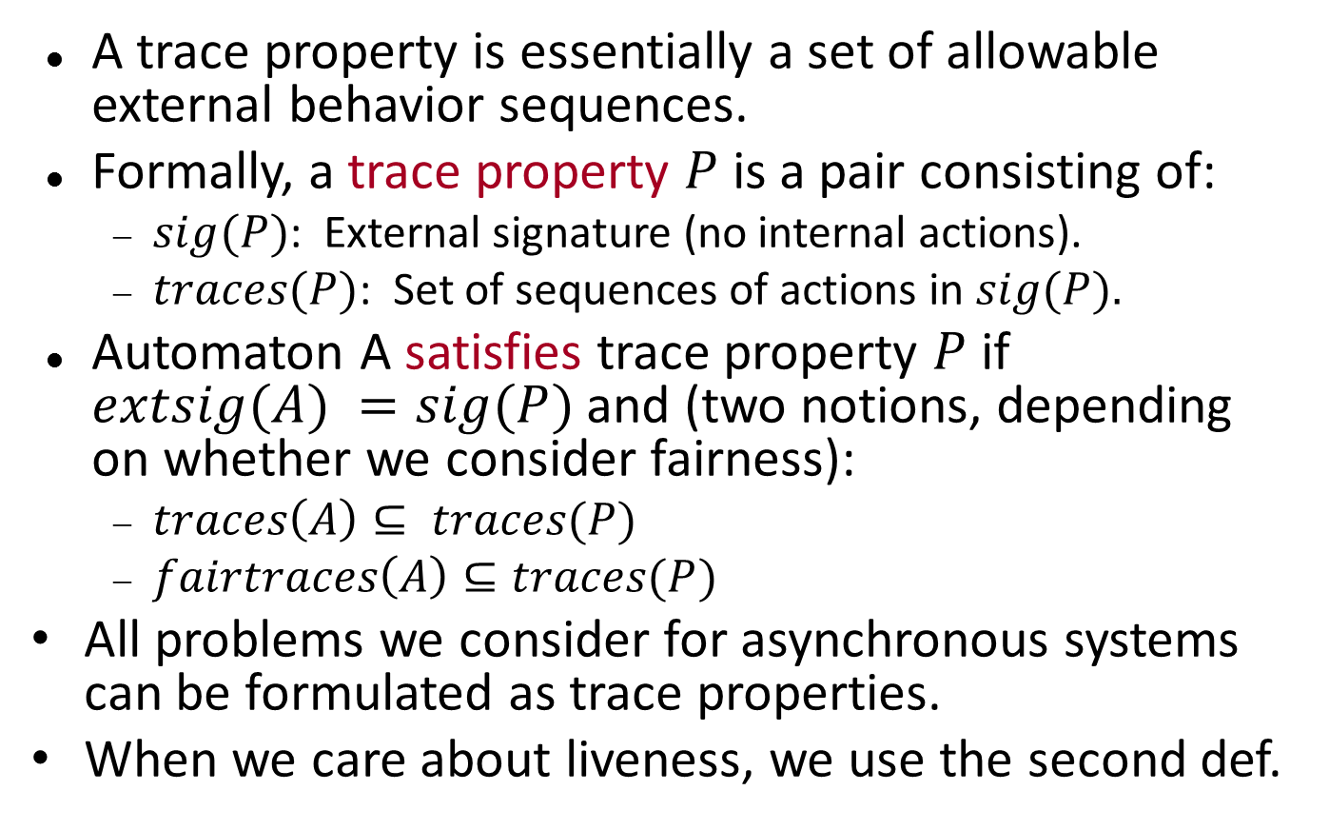
Trace properties
A trace property is essentially a set of allowable external behavior sequences.
Formally, a trace property $P$ is a pair consisting of:
$sig(P)$: External signature (no internal actions).
$traces(P)$: Set of sequences of actions in $sig(P).$
Automaton A satisfies trace property $P$ if $extsig(A) =sig(P)$and (two notions, depending on whether we consider fairness):
$traces\left(A\right)⊆ traces(P)$
$fairtraces\left(A\right)⊆traces(P)$
All problems we consider for asynchronous systems can be formulated as trace properties.
When we care about liveness, we use the second def.

Slide 12
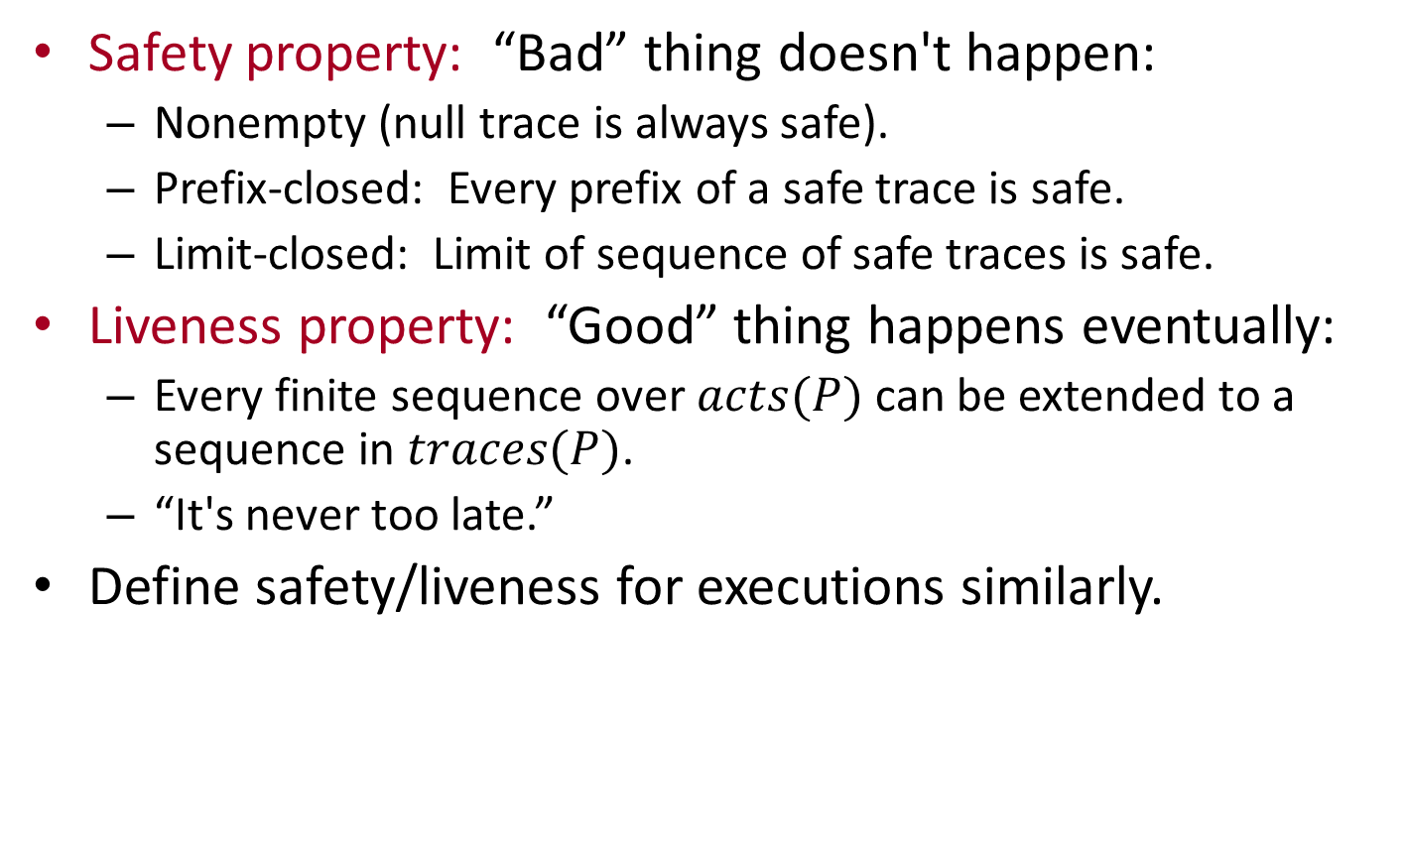
Safety and liveness properties
Safety property: “Bad” thing doesn't happen:
Nonempty (null trace is always safe).
Prefix-closed: Every prefix of a safe trace is safe.
Limit-closed: Limit of sequence of safe traces is safe.
Liveness property: “Good” thing happens eventually:
Every finite sequence over $acts(P)$can be extended to a sequence in $traces(P)$.
“It's never too late.”
Define safety/liveness for executions similarly.

Slide 13
Safety property S
traces(S) are nonempty, prefix-closed, limit-closed.
Examples:
Consensus: Agreement, validity
Describe as set of sequences of init and decide actions in which we never disagree, or never violate validity.
Graph algorithms: Correct shortest paths, correct MSTs,…
Outputs do not yield any incorrect answers.
Mutual exclusion: No two grants without intervening return.
Notes:
Go over why these are all safety properties: Empty sequence doesn’t violate; If trace is OK then so are all prefixes; If all prefixes are OK then trace is OK.

Slide 14
Proving a safety property
That is, prove that all traces of A satisfy S.
By limit-closure, it’s enough to prove that all finite traces satisfy S.
Use invariants:
Find an invariant corresponding to the trace safety property.
Example: Consensus
Record decisions in the state.
Express agreement and validity in terms of recorded decisions.
Then prove the invariant by induction.

Slide 15
Liveness property L
Every finite sequence over sig(L) has an extension in traces(L).
Examples:
Temination: No matter where we are, we could still terminate in the future.
Some event happens infinitely often.
Proving liveness properties:
Measure progress toward goals, using progress functions.
Intermediate milestones.
Formal logical reasoning using temporal logic.
Methods are less agreed-upon than those for safety properties.

Slide 16
Safety and liveness
Theorem: Every trace property can be expressed as the intersection of a safety property and a liveness property.
So, to define a problem to be solved by an asynchronous system, it’s enough to specify safety requirements and liveness requirements separately.
This explains why typical specifications of problems for asynchronous systems consist of:
A list of safety properties.
A list of liveness properties.
And nothing else.
Notes:
Proof of the theorem is in the book. It’s simple.

Slide 17
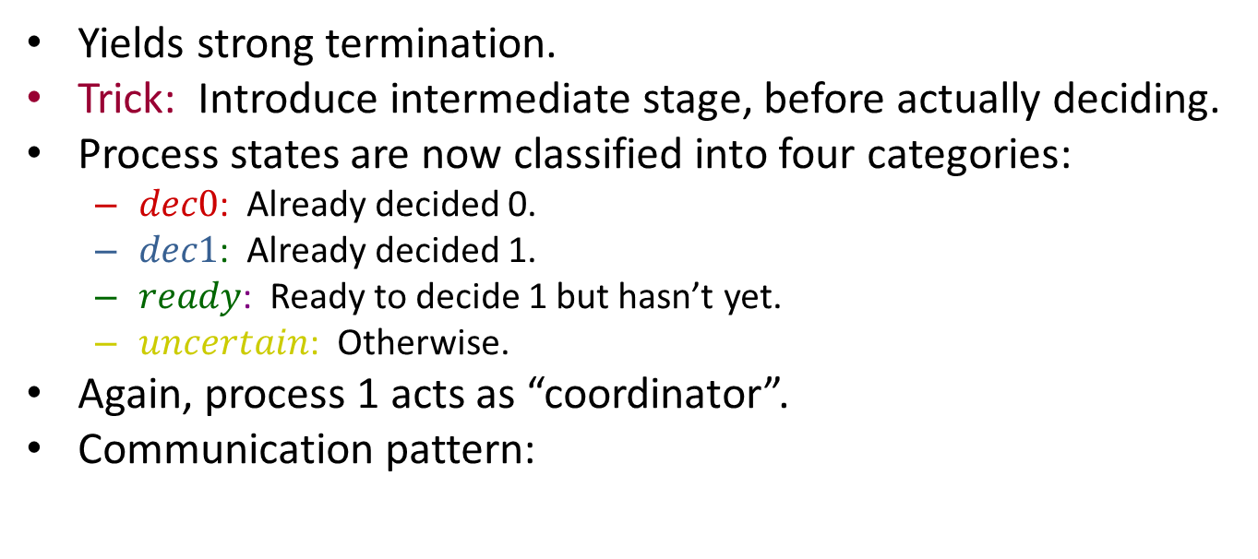
Automata as specifications
Every I/O automaton specifies a trace property $(extsig(A), traces(A)).$
So we can use an automaton as a problem specification.
Automaton $A$ “implements” automaton $B$ if
$extsig(A) = extsig(B)$
$traces\left(A\right)⊆traces(B)$
Notes:
“Implements” can mean different things, depending on whether we consider fairness. Here, we don’t.

Slide 18
Hierarchical proofs
Important strategy for proving correctness of complex asynchronous distributed algorithms.
Define a series of automata, each implementing the previous one (“successive refinement”).
Highest-level automaton model captures the “real” problem specification.
Next level is a high-level algorithm description.
Successive levels represent more and more detailed versions of the algorithm.
Lowest level is the full algorithm description.
Abstract spec
High-level
algorithm
description
Detailed
Algorithm
description
Notes:
“Implements” can mean different things, depending on whether we consider fairness. Here, we don’t.

Slide 19
Hierarchical proofs
For example:
High levels centralized, lower levels distributed.
High levels inefficient but simple, lower levels optimized and more complex.
High levels with large granularity steps, lower levels with finer granularity steps.
In all these cases, lower levels are harder to understand and reason about.
So instead of reasoning about them directly, relate them to higher-level descriptions.
Method similar to what we saw for synchronous algorithms.
Abstract spec
High-level
algorithm
description
Detailed
Algorithm
description

Slide 20
Hierarchical proofs
Recall, for synchronous algorithms:
Optimized algorithm runs side-by-side with unoptimized version, and “invariant” proved to relate the states of the two algorithms.
Prove using induction.
For asynchronous systems, it’s harder:
Asynchronous model has more nondeterminism (in choice of new state, in order of steps).
So, it’s harder to determine which executions to compare.
One-way implementation relationship is enough:
For each execution of the lower-level algorithm, there is a corresponding execution of the higher-level algorithm.
“Everything the algorithm does is allowed by the spec.”
Don’t need the other direction: it doesn’t matter if the algorithm does everything that is allowed.
Abstract spec
High-level
algorithm
description
Detailed
Algorithm
description
Notes:
Also similar to abstraction function methods for data types, in object-oriented programming.

Slide 21
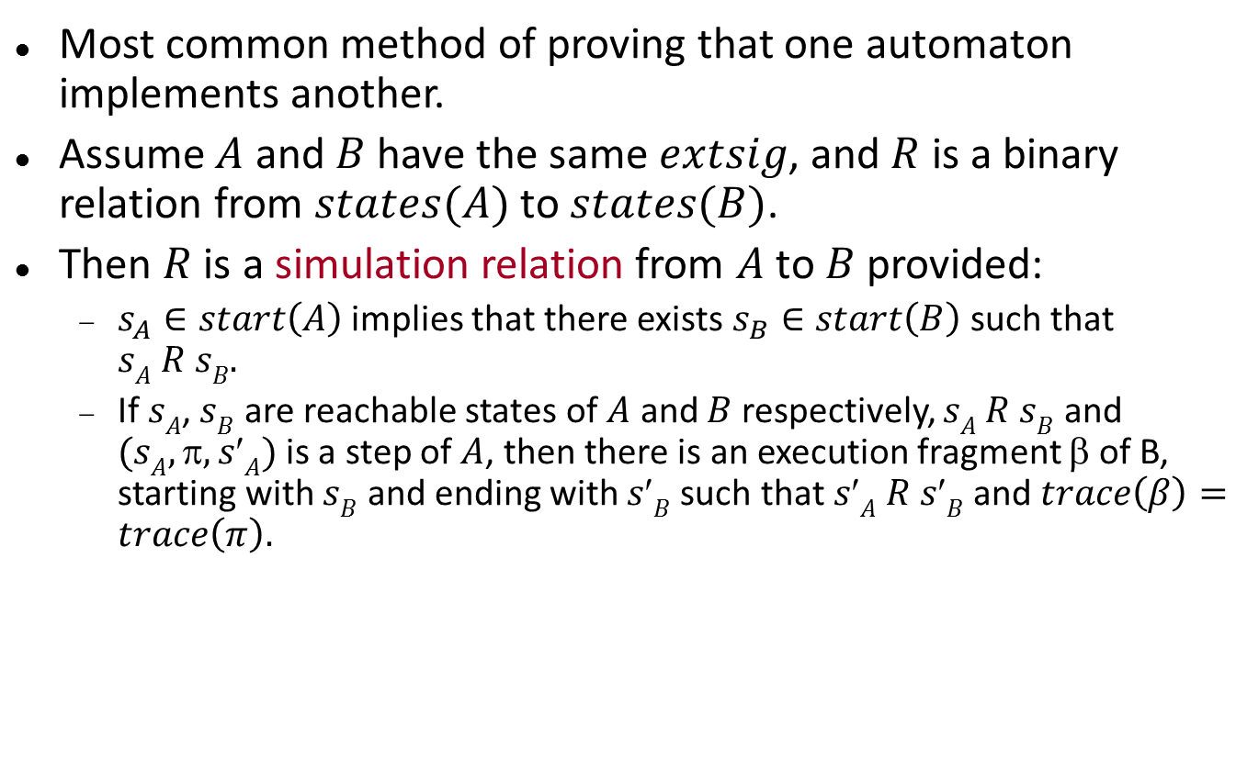
Simulation relations
Most common method of proving that one automaton implements another.
Assume $A$ and $B$ have the same $extsig$, and $R$ is a binary relation from $states(A)$ to $states(B)$.
Then $R$ is a simulation relation from $A$ to $B$ provided:
$s_{A}∈start\left(A\right)$ implies that there exists $s_{B}∈start\left(B\right)$such that $sA R sB.$
If $sA$, $sB$ are reachable states of $A$ and $B$ respectively, $sA R sB$ and $(sA, , sA)$is a step of $A$, then there is an execution fragment β of B, starting with $sB$ and ending with $sB$such that $sA R sB$and $trace\left(β\right)=trace\left(π\right).$

Slide 22
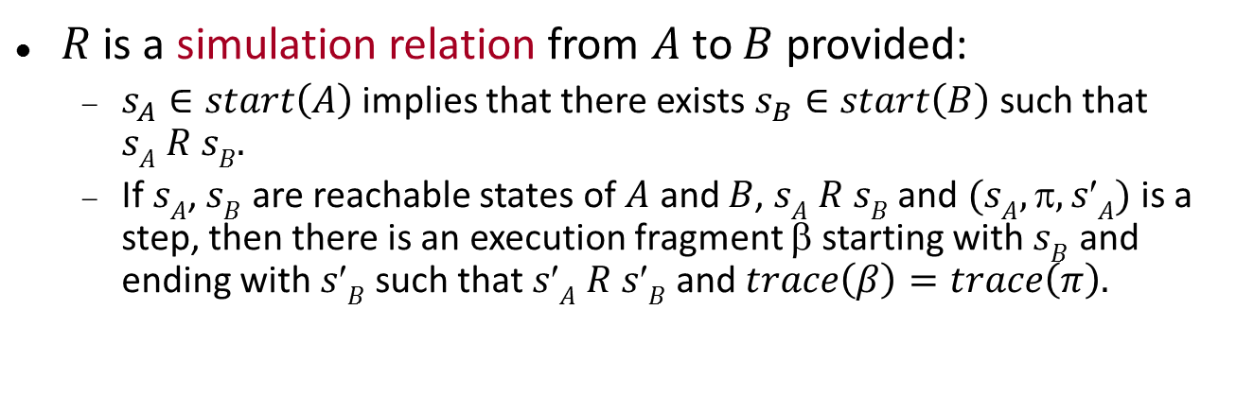
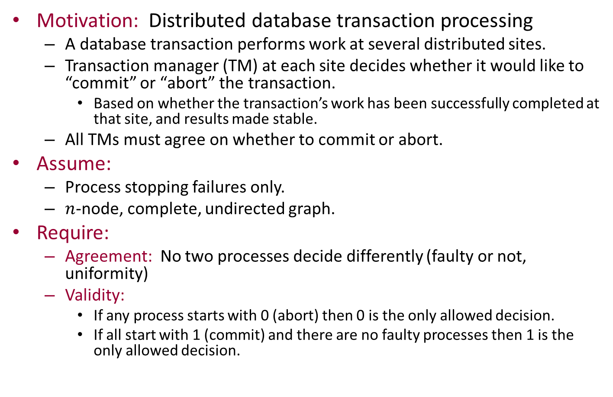

Simulation relations
s_{B}
$$β$$
s′_{B}
R
R
$$π$$
s_{A}
s′_{A}
$R$ is a simulation relation from $A$ to $B$ provided:
$s_{A}∈start\left(A\right)$ implies that there exists $s_{B}∈start\left(B\right)$such that $sA R sB.$
If $sA$, $sB$ are reachable states of $A$ and $B$, $sA R sB$ and $(sA, , sA)$is a step, then there is an execution fragment β starting with $sB$ and ending with $sB$such that $sA R sB$and$trace\left(β\right)=trace\left(π\right).$
Notes:
Beta can consist of 0, 1, or more steps, as long as it looks the same externally.
If pi is an external action, then beta must consist of pi and 0 or more internal actions.
If pi is an internal action, then beta must consist of just 0 or more internal actions.

Slide 23


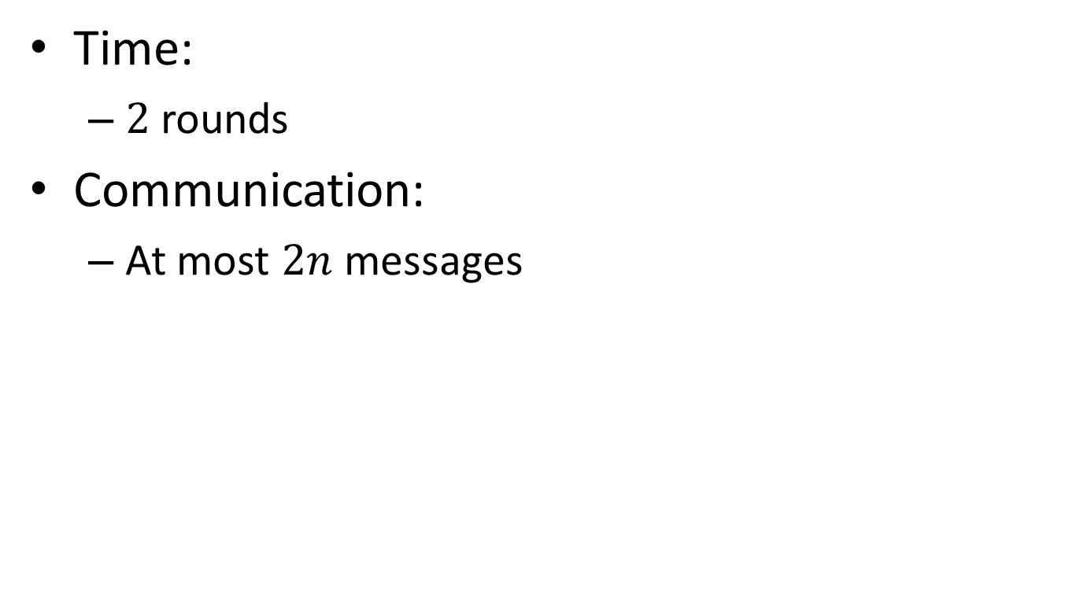



Simulation relations
Theorem: If there is a simulation relation from $A$ to $B$ then $traces\left(A\right)⊆traces\left(B\right).$
All traces of $A,$ not just finite traces.
Proof: Fix a trace of $A$, arising from a (possibly infinite) execution of $A$.
Create a corresponding execution of $B$, using an iterative construction.
$$π_{1}$$
$$π_{2}$$
$$π_{3}$$
$$π_{4}$$
$$π_{5}$$
s_{0,A}
s_{1,A}
s_{2,A}
s_{3,A}
s_{4,A}
s_{5,A}

Slide 24

Simulation relations
Theorem: If there is a simulation relation from $A$ to $B$ then $traces\left(A\right)⊆traces\left(B\right).$
s_{0,B}
R
$$π_{1}$$
$$π_{2}$$
$$π_{3}$$
$$π_{4}$$
$$π_{5}$$
s_{0,A}
s_{1,A}
s_{2,A}
s_{3,A}
s_{4,A}
s_{5,A}
Notes:
Use the start condition to get a corresponding start state of B.

Slide 25
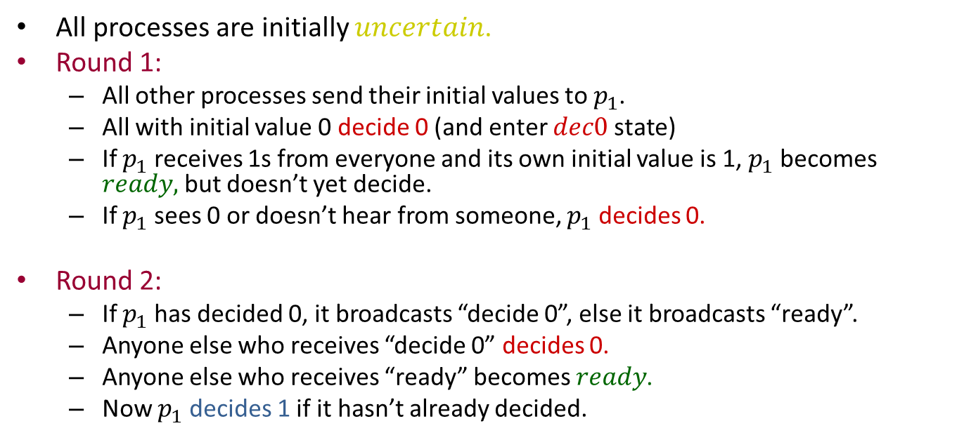
Simulation relations
Theorem: If there is a simulation relation from $A$ to $B$ then $traces\left(A\right)⊆traces\left(B\right).$
$$β_{1}$$
s_{0,B}
s_{1,B}
R
R
$$π_{1}$$
$$π_{2}$$
$$π_{3}$$
$$π_{4}$$
$$π_{5}$$
s_{0,A}
s_{1,A}
s_{2,A}
s_{3,A}
s_{4,A}
s_{5,A}
Notes:
Then use the step condition to get the first portion of the execution of B, ending in a state that corresponds with s_1,A.

Slide 26
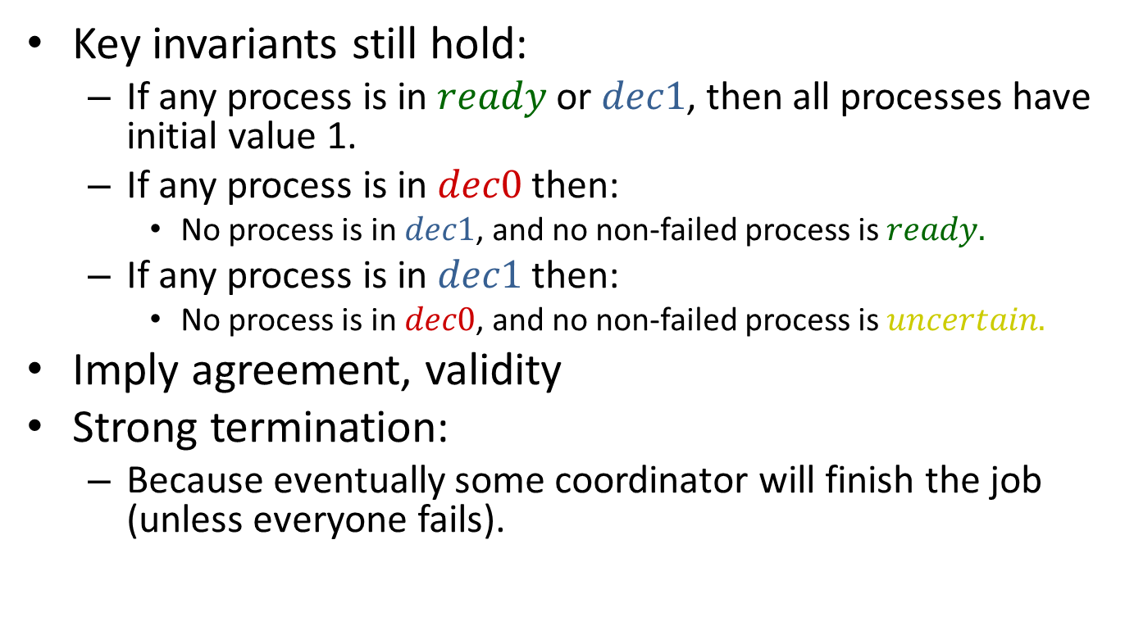
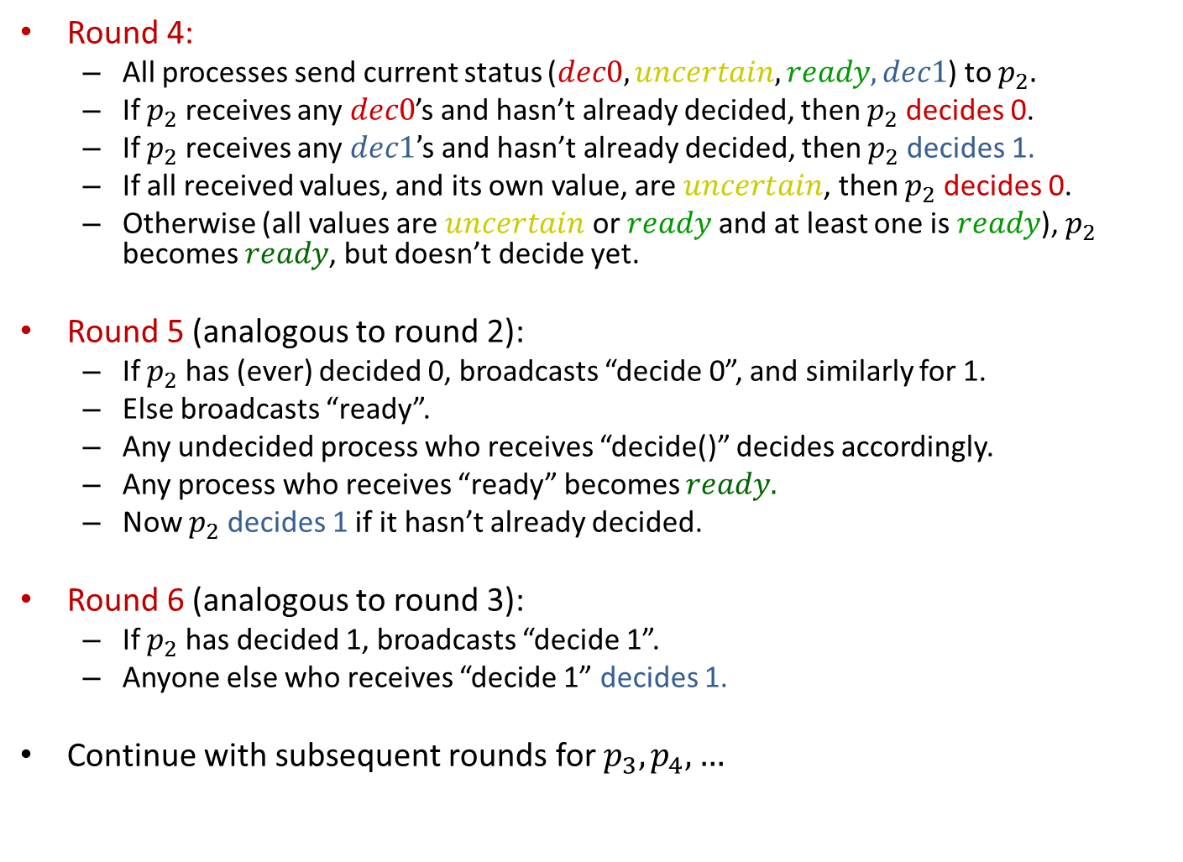
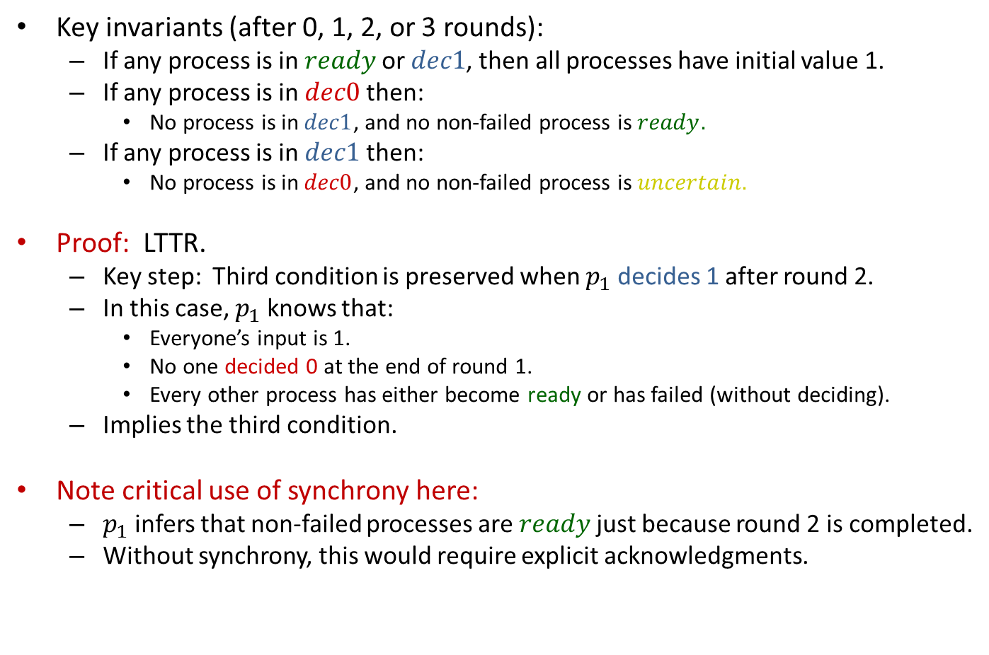
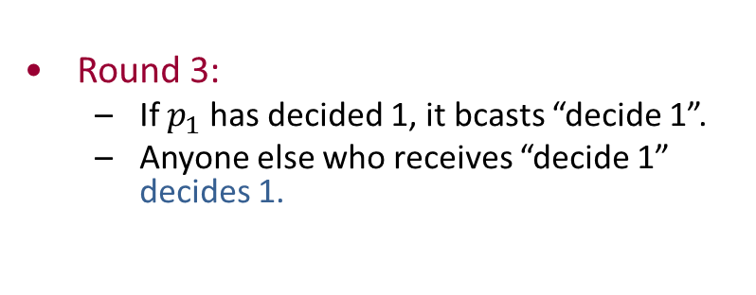
Simulation relations
Theorem: If there is a simulation relation from $A$ to $B$ then $traces\left(A\right)⊆traces\left(B\right).$
$$β_{1}$$
$$β_{2}$$
$$β_{3}$$
$$β_{4}$$
$$β_{5}$$
s_{0,B}
s_{1,B}
s_{2,B}
s_{3,B}
s_{4,B}
s_{5,B}
R
R
R
R
R
R
$$π_{1}$$
$$π_{2}$$
$$π_{3}$$
$$π_{4}$$
$$π_{5}$$
s_{0,A}
s_{1,A}
s_{2,A}
s_{3,A}
s_{4,A}
s_{5,A}
Notes:
And continue. It’s easy to see that we get the same trace, as needed.
This construction works for finite or infinite executions of A.
It says nothing about fairness.

Slide 27

Example: Channels
Show two channels implement one.
Rename $receive(m)$ of $B$ and $send(m)$of $A$ to $pass(m)$.
Let $D=hide_{\left\{pass\left(m\right)\right\}}$ $(A×B).$
Show that $traces\left(D\right)⊆traces(C).$
send(m)
receive(m)
C
send(m)
pass(m)
receive(m)
B
A

Slide 28
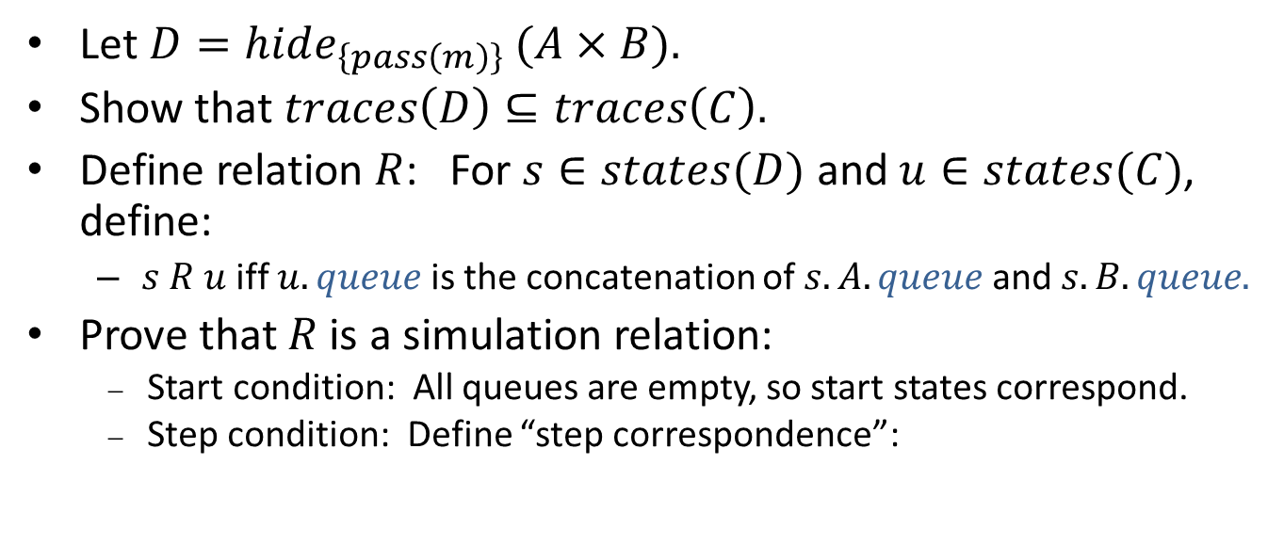
Two channels implement one
send(m)
pass(m)
receive(m)
B
A
Let $D=hide_{\left\{pass\left(m\right)\right\}}$ $(A×B).$
Show that $traces\left(D\right)⊆traces\left(C\right).$
Define relation $R$: For $s∈states(D)$ and $u∈states(C)$, define:
$s R u$iff $u.queue$ is the concatenation of $s.A.queue$ and $s.B.queue.$
Prove that $R$ is a simulation relation:
Start condition: All queues are empty, so start states correspond.
Step condition: Define “step correspondence”:

Slide 29
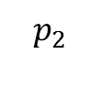
Two channels implement one
send(m)
pass(m)
receive(m)
B
A
s R u iff u.queue is concatenation of s.A.queue and s.B.queue
Step correspondence:
For each step $\left(s,π,s^{′}\right)∈trans(D)$ and $u$ such that $s R u$, define execution fragment β of $C$:
Starts with $u$, ends with $u$ such that $s R u.$
trace(β) = trace(π)
Here, actions in β depend only on π, and uniquely determine the states.
Same action if external, empty sequence if internal.

Slide 30
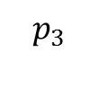
Two channels implement one
send(m)
pass(m)
receive(m)
B
A
s R u iff u.queue is concatenation of s.A.queue and s.B.queue
Step correspondence:
π $=send(m)$in $D$ corresponds to $send(m)$in $C$
π $=receive(m)$ in $D$ corresponds to $receive(m)$ in $C$
π $=pass(m)$ in $D$corresponds to λ in $C$
Verify that this works:
Same external actions (yes).
Actions of $C$ are enabled.
Final states related by relation $R$.
Routine case analysis:

Slide 31
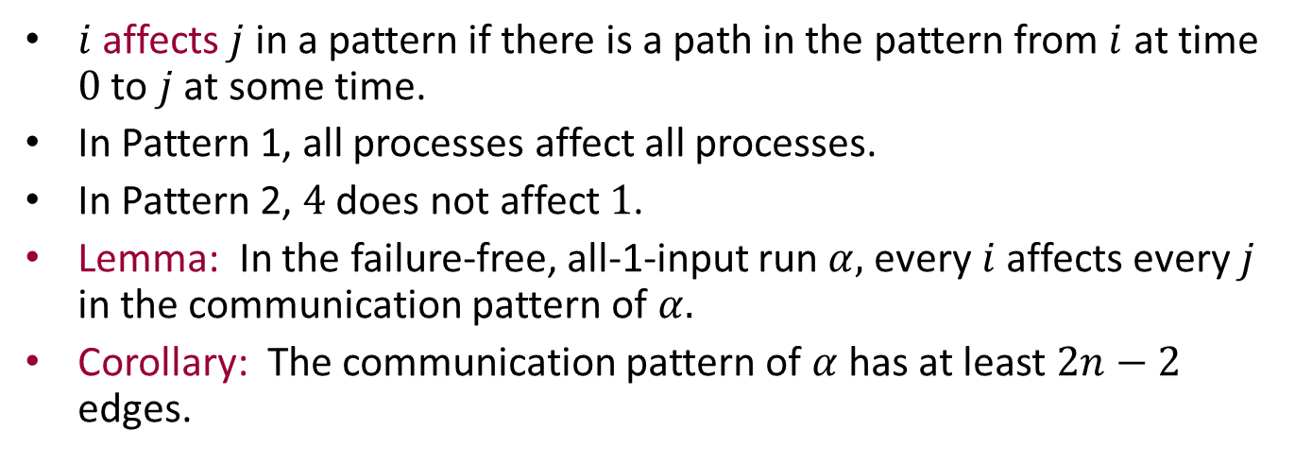

Showing $R$ is a simulation relation
s R u iff u.queue is concatenation of s.A.queue and s.B.queue
Case 1: π $=send(m)$
No enabling issues (input).
Must check that $s R u.$
Since $s R u$, $u.queue$ is the concatenation of $s.A.queue$ and $s.B.queue$.
Adding the same $m$ to the end of $u.queue$and $s.B.queue$ maintains the correspondence.
Case 2: π $= receive(m)$
Enabling: Check that $receive(m)$, for the same $m$, is also enabled in $u$.
We know that $m$ is first on $s.A.queue.$
Since $s R u$, $m$ is also first on $u.queue.$
So $receive(m)$is enabled in $u$.
$s R u$: Since $m$ is removed from both $s.A.queue$ and $u.queue.$

Slide 32
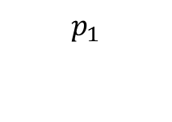
Showing R is a simulation relation
s R u iff u.queue is concatenation of s.A.queue and s.B.queue
Case 3: π $= pass(m)$
No enabling issues (since no high-level steps are involved).
Must check $s R u:$
Since $s R u$, $u.queue$ is the concatenation of $s.A.queue$ and $s.B.queue$.
The concatenation of the queues is unchanged as a result of this step, so also $u.queue$ is the concatenation of $s.A.queue$and $s.B.queue$.
u
R
R
s
s′
pass(m)
Notes:
And all this could be checked with a theorem-prover.

Slide 33
Asynchronous network model

Slide 34
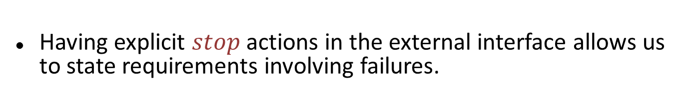
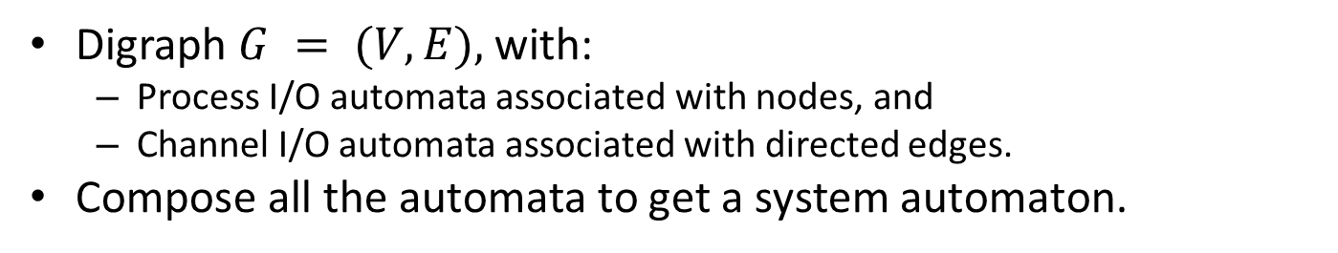
Send/Receive System
Digraph $G = (V,E),$with:
Process I/O automata associated with nodes, and
Channel I/O automata associated with directed edges.
Compose all the automata to get a system automaton.
Process:
User interface actions, e.g., invocations and responses
Send/receive actions for interaction with channels
Problems specified in terms of allowable traces at the user interface.
Hide send/receive actions.
Failure modeling:
resp(v)_{i}
inv(x)_{i}
p_{i}
stop₁
p_{i}
send(m)_{i,j}
receive(m)_{j,i}
Having explicit $stop$ actions in the external interface allows us to state requirements involving failures.

Slide 35
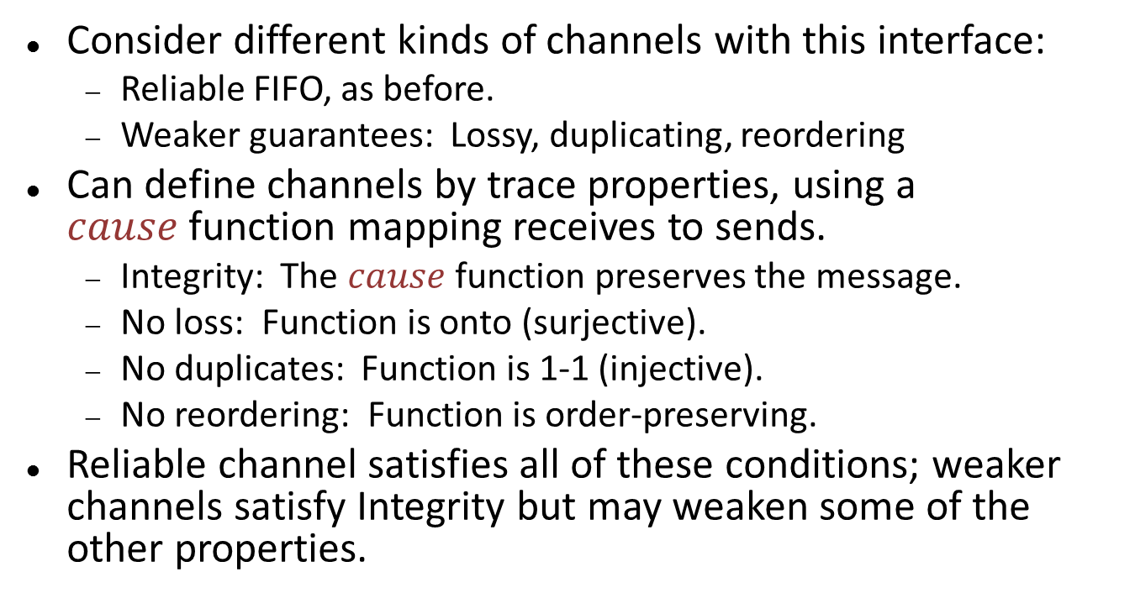
Channel automata
send(m)_{i,j}
C_{i,j}
receive(m)_{i,j}
Consider different kinds of channels with this interface:
Reliable FIFO, as before.
Weaker guarantees: Lossy, duplicating, reordering
Can define channels by trace properties, using a $cause$function mapping receives to sends.
Integrity: The $cause$ function preserves the message.
No loss: Function is onto (surjective).
No duplicates: Function is 1-1 (injective).
No reordering: Function is order-preserving.
Reliable channel satisfies all of these conditions; weaker channels satisfy Integrity but may weaken some of the other properties.
Notes:
We write the explicit “cause” correspondence because we might have repeated occurrences of sends for the same message, in which case it wouldn’t be clear which send “caused” which receive.
Here we simply specify that there should exist some correspondence.

Slide 36
Broadcast and multicast systems
Broadcast
Reliable FIFO between each pair.
Different processes can receive messages from different senders in different orders.
Model abstractly using separate queues for each pair.
Multicast: Processes designate recipients.
rcv(m)_{i,1}
bcast(m)_{n}
bcast(m)₁
rcv(m)_{i,n}
Broadcast
Notes:
Not exactly like a collection of pairwise channels; here, a single bcast event puts the message on all the outgoing channels, in one step.

Slide 37
Asynchronous network algorithms

Slide 38
Asynchronous network algorithms
Consider send/receive systems with reliable FIFO point-to-point channels
Revisit problems we considered in synchronous networks:
Leader election, in a ring, and in general undirected networks.
Spanning tree
Breadth-first search
Shortest paths
Minimum spanning tree
What results carry over?
Where did we use the synchrony assumption?
Notes:
What results carry over, and what changes do we see, e.g., in the costs?

Slide 39
Algorithms for Leader Election in a Ring

Slide 40
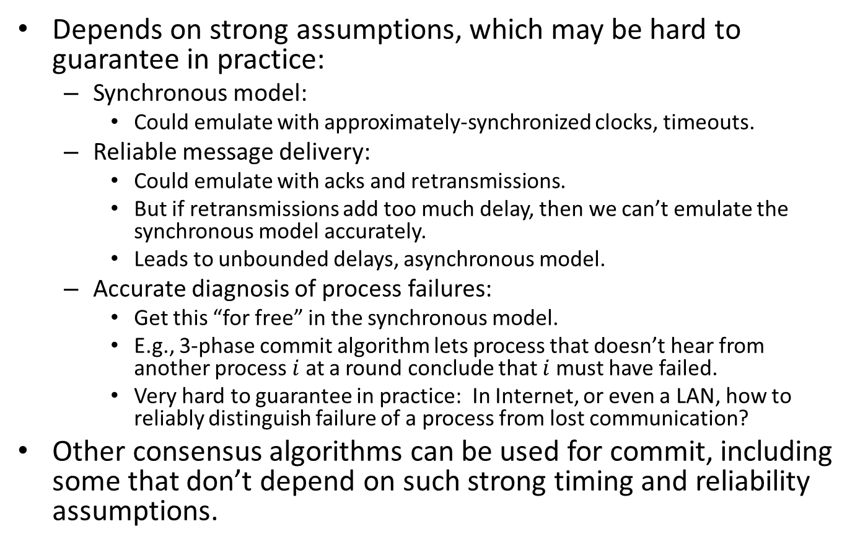
Leader election in a ring
Assumptions:
$G$ is a ring, with unidirectional or bidirectional communication
Local names for neighbors, UIDs
$AsynchLCR$[LeLann] [Chang-Roberts]
Send UID clockwise around ring (unidirectional).
Discard UIDs smaller than your own.
Elect yourself if your UID comes back.
Correctness: Basically the same as for synchronous version, with a few complications:
Finer granularity, must consider individual steps rather than entire rounds.
Must consider messages in channels.

Slide 41

$AsynchLCR$, process $i$
Signature
in rcv(v)_{i-1,i}, v a UID
out send(v)_{i,i+1}, v a UID
out leader_{i}
State variables
u, a UID, initially i’s UID
send, a FIFO queue of UIDs, initially containing i’s UID
status, unknown, chosen, or reported, initially unknown
Tasks
{ send(v)_{i,i+1} | v is a UID }
{ leader_{i} }
Transitions
send(v)_{i,i+1} pre: v = head(send)
eff: remove head of send
receive(v)_{i-1,i} eff: if v = u then status := chosen if v > u then add v to send
leader_{i} pre: status = chosen eff: status := reported

Slide 42


$AsynchLCR$ properties
Safety: No process $i  imax$ever performs $leaderi.$
Liveness: $imax$eventually performs $leader_{imax}.$

Slide 43
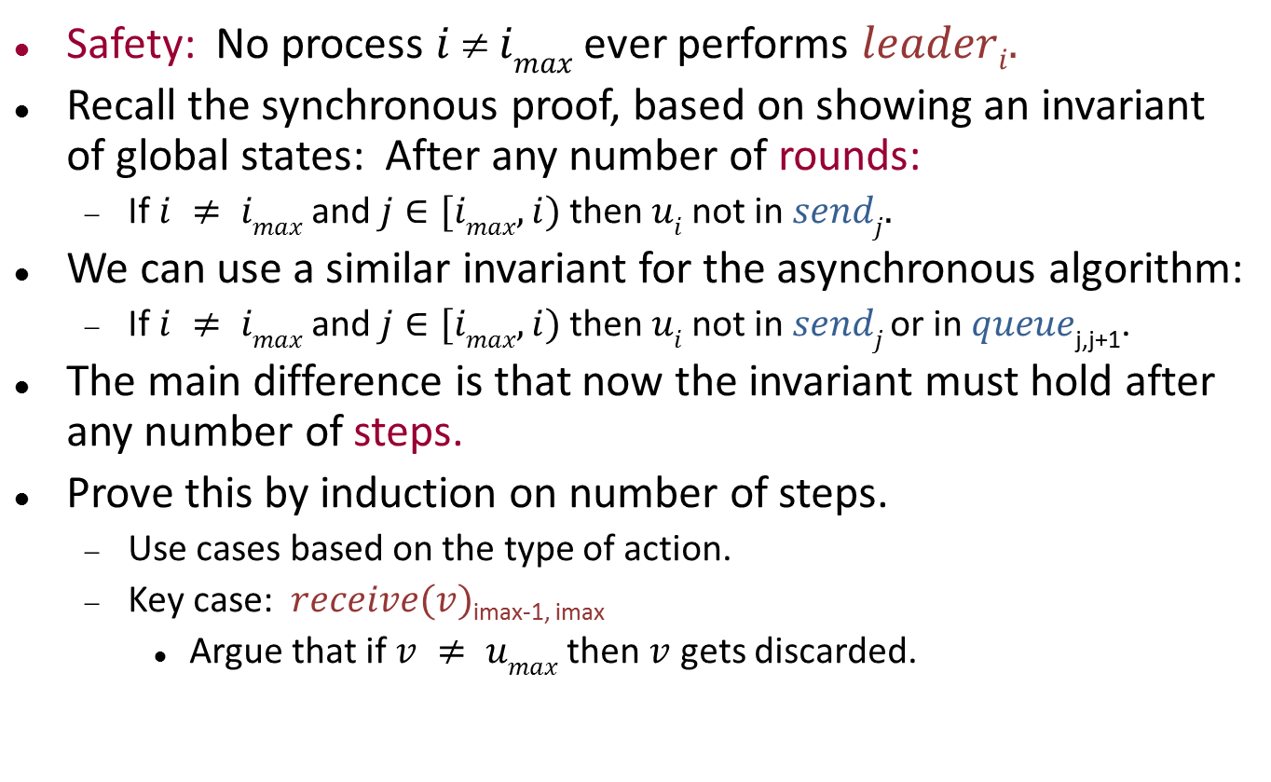
Safety proof
Safety: No process $i  imax$ever performs $leaderi.$
Recall the synchronous proof, based on showing an invariant of global states: After any number of rounds:
If $i ≠ imax$and $j∈[imax, i)$then $ui$not in $sendj.$
We can use a similar invariant for the asynchronous algorithm:
If $i ≠ imax$and $j∈[imax, i)$then $ui$not in $sendj$or in $queue$_{j,j+1}.
The main difference is that now the invariant must hold after any number of steps.
Prove this by induction on number of steps.
Use cases based on the type of action.
Key case: $receive(v)$_{imax-1, imax}
Argue that if $v ≠ umax$then $v$ gets discarded.

Slide 44
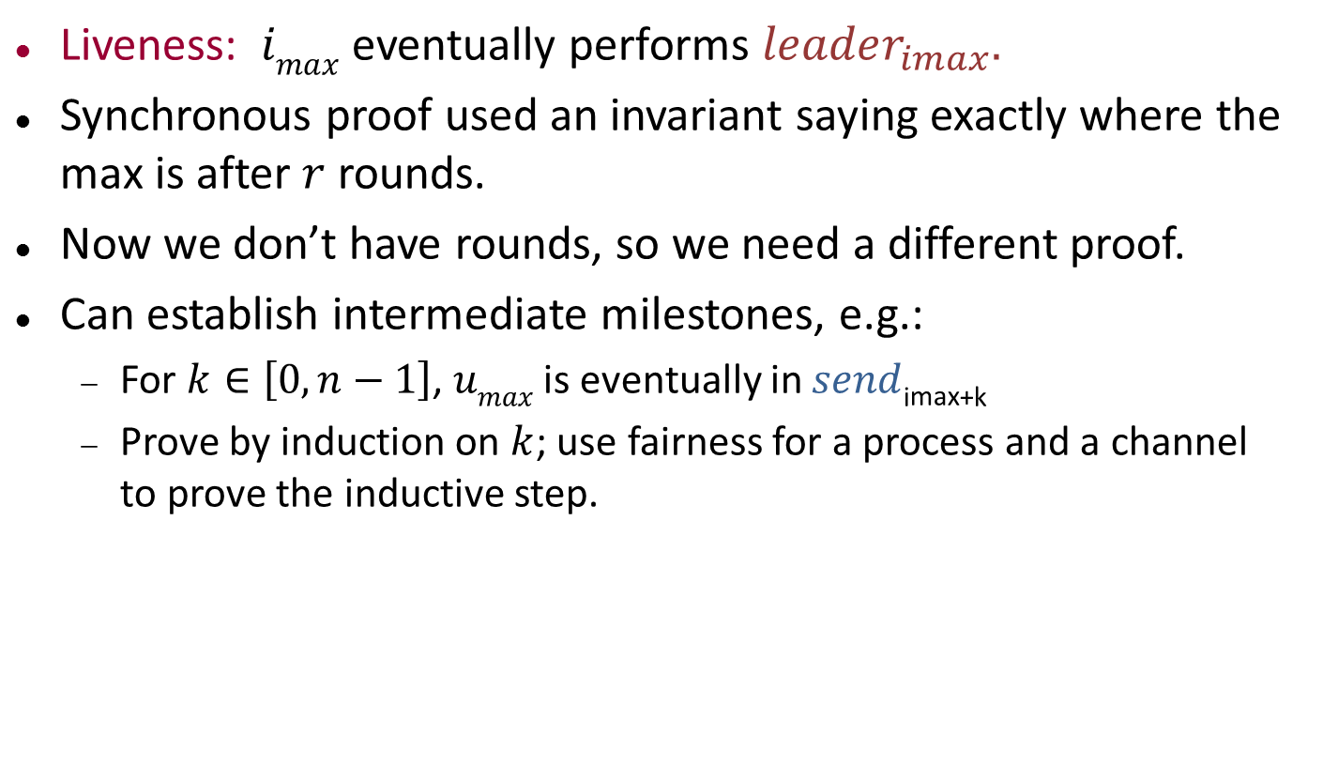
Liveness proof
Liveness: $imax$ eventually performs $leader_{imax}.$
Synchronous proof used an invariant saying exactly where the max is after $r$ rounds.
Now we don’t have rounds, so we need a different proof.
Can establish intermediate milestones, e.g.:
For $k∈\left[0,n−1\right]$, $umax$ is eventually in $send$_{imax+k}
Prove by induction on $k$; use fairness for a process and a channel to prove the inductive step.

Slide 45
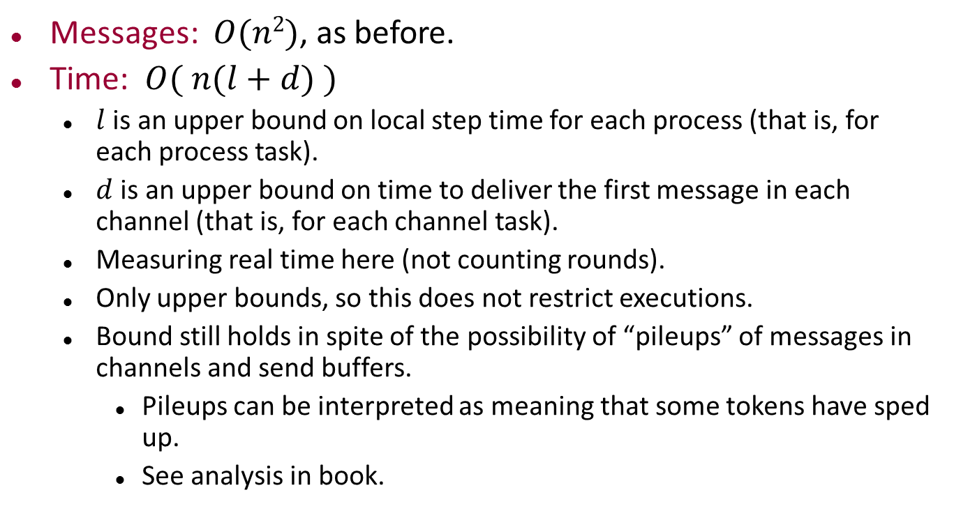
Complexity
Messages: $O(n2)$, as before.
Time: $O( n(l+d) )$
$l$ is an upper bound on local step time for each process (that is, for each process task).
$d$ is an upper bound on time to deliver the first message in each channel (that is, for each channel task).
Measuring real time here (not counting rounds).
Only upper bounds, so this does not restrict executions.
Bound still holds in spite of the possibility of “pileups” of messages in channels and send buffers.
Pileups can be interpreted as meaning that some tokens have sped up.
See analysis in book.
Notes:
Proof is by induction on multiples of (l+d), showing that all tokens make at least the progress they should by that time.

Slide 46
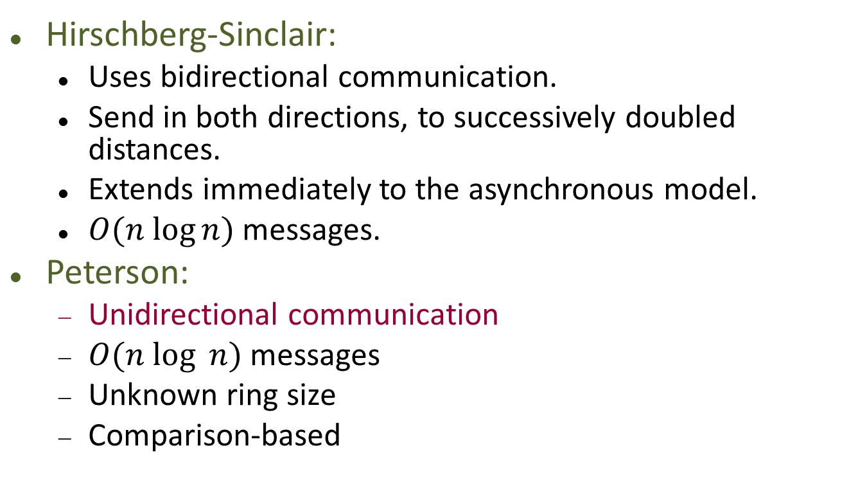
Reducing the message complexity
Hirschberg-Sinclair:
Uses bidirectional communication.
Send in both directions, to successively doubled distances.
Extends immediately to the asynchronous model.
$O(n log⁡n)$messages.
Peterson:
Unidirectional communication
$O(n log⁡ n)$messages
Unknown ring size
Comparison-based

Slide 47
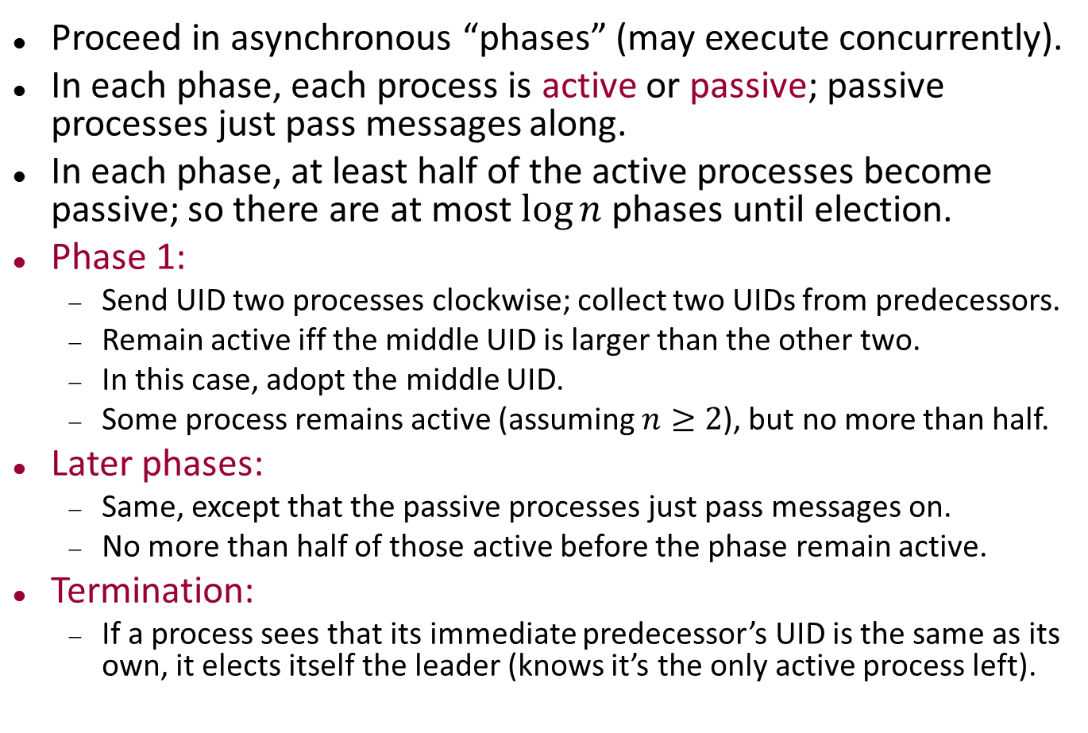
Peterson’s algorithm
Proceed in asynchronous “phases” (may execute concurrently).
In each phase, each process is active or passive; passive processes just pass messages along.
In each phase, at least half of the active processes become passive; so there are at most $log⁡n$ phases until election.
Phase 1:
Send UID two processes clockwise; collect two UIDs from predecessors.
Remain active iff the middle UID is larger than the other two.
In this case, adopt the middle UID.
Some process remains active (assuming $n≥2$), but no more than half.
Later phases:
Same, except that the passive processes just pass messages on.
No more than half of those active before the phase remain active.
Termination:
If a process sees that its immediate predecessor’s UID is the same as its own, it elects itself the leader (knows it’s the only active process left).

Slide 48
PetersonLeader
Signature
in receive(v)_{i-1,i}, v a UID
out send(v)_{i,i+1}, v a UID
out leader_{i}
int get-second-uid_{i}
int get-third-uid_{i}
int advance-phase_{i}
int become-relay_{i}
int relay_{i}
State variables
mode: active or relay, initially active
status: unknown, chosen, or reported, initially unknown
uid1, initially i's UID
uid2, initially null
uid3, initially null
send, FIFO queue of UIDs; initially contains just i's UID
receive: FIFO queue of UIDs,
initially empty

Slide 49
PetersonLeader
get-second-uid_{i} pre: mode = active receive is nonempty uid2 = null eff: uid2 := head(receive) remove head of receive add uid2 to send if uid2 = uid1 then status := chosen
get-third-uid_{i} pre: mode = active receive is nonempty uid2 ≠ null uid3 = null eff: uid3 := head(receive) remove head of receive
advance-phase_{i} pre: mode = active uid3 ≠ null uid2 > max(uid1, uid3) eff: uid1 := uid2 uid2, uid3 := null add uid1 to send
become-relay_{i} pre: mode = active uid3 ≠ null uid2 ≤ max(uid1, uid3) eff: mode := relay
relay_{i} pre: mode = relay receive is nonempty eff: move head(receive) to send
Notes:
Skipping some rather standard code for send and receive.
Also for the leader announcement.

Slide 50
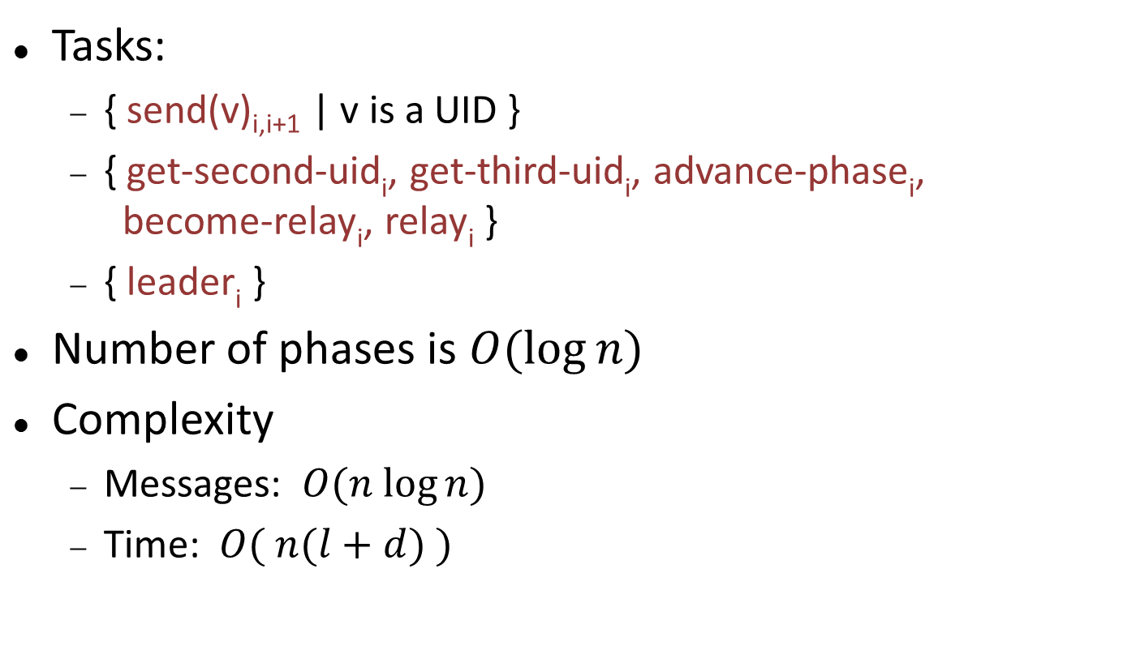
PetersonLeader
Tasks:
{ send(v)_{i,i+1} | v is a UID }
{ get-second-uid_{i}, get-third-uid_{i}, advance-phase_{i}, become-relay_{i}, relay_{i} }
{ leader_{i} }
Number of phases is $O(log⁡n)$
Complexity
Messages: $O(n log⁡n)$
Time: $O( n(l+d) )$
Notes:
The message bound results from log n phases, O(n) messages per phase.
The time bound isn’t obvious---technical argument in book.

Slide 51
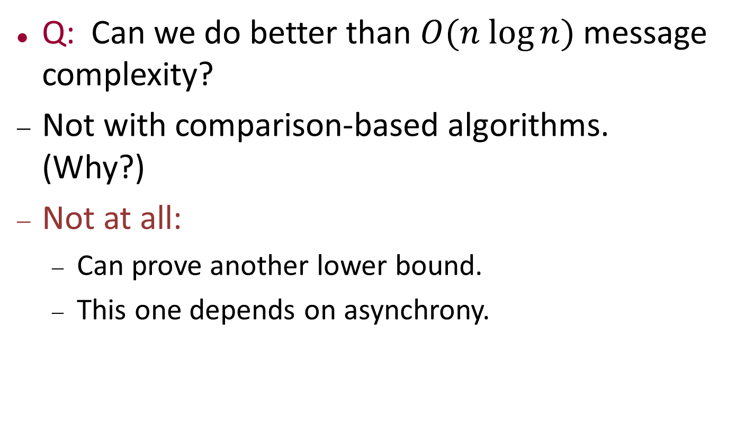
Leader election in a ring
Q: Can we do better than $O(n log⁡n)$message complexity?
Not with comparison-based algorithms. (Why?)
Not at all:
Can prove another lower bound.
This one depends on asynchrony.
Notes:
Can’t do better with comparison-based because of the lower bound for synchronous networks that we already proved.

Slide 52
Lower Bound for Leader Election in a Ring

Slide 53

$(n log⁡n)$lower bound
Lower bound for leader election in asynchronous ring network.
Assume:
Ring size n is unknown (algorithm must work in arbitrary size rings).
UIDS:
Chosen from some infinite set.
No restriction on allowable operations.
All processes are identical except for UIDs.
Bidirectional communication allowed.
Consider combinations of processes to form:
Rings, as usual.
Lines, where nothing is connected to the ends and no input arrives at the ends.
Ring looks like a line if communication is delayed across a boundary.

Slide 54

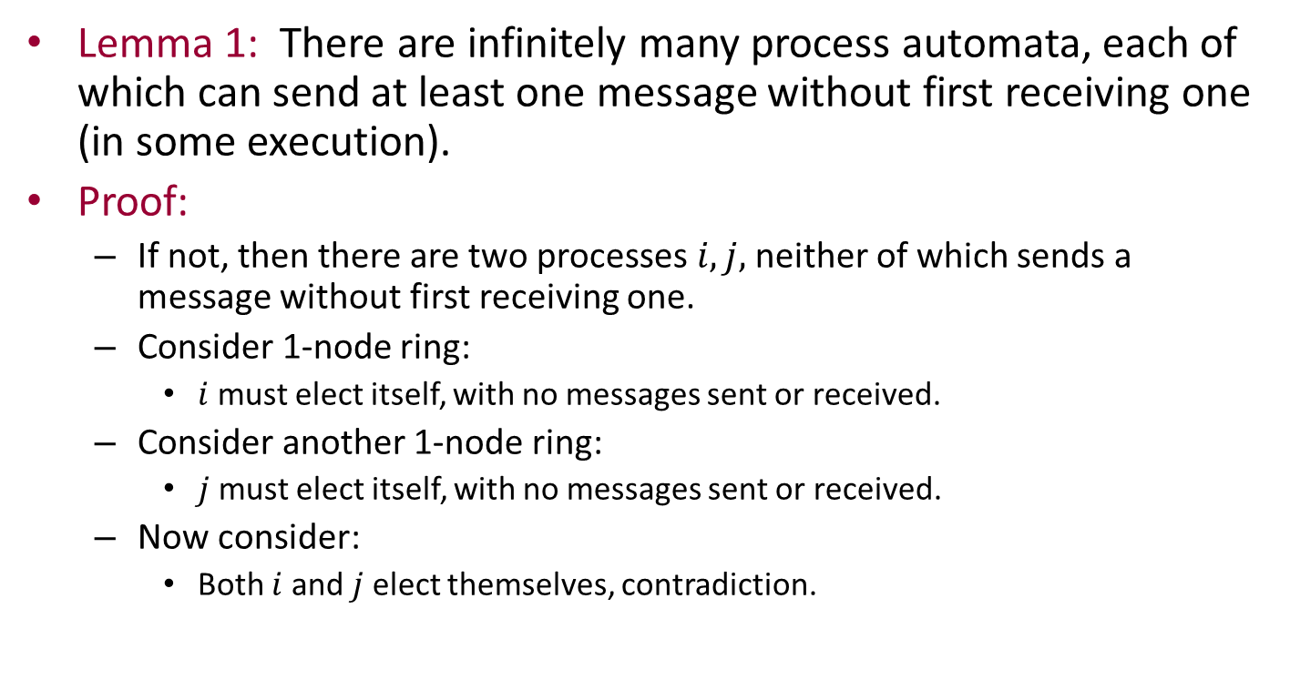
$(n log⁡n)$lower bound
Lemma 1: There are infinitely many process automata, each of which can send at least one message without first receiving one (in some execution).
Proof:
If not, then there are two processes $i,j,$ neither of which sends a message without first receiving one.
Consider 1-node ring:
$i$ must elect itself, with no messages sent or received.
Consider another 1-node ring:
$j$ must elect itself, with no messages sent or received.
Now consider:
Both $i$ and $j$ elect themselves, contradiction.
i
j
i
j

Slide 55
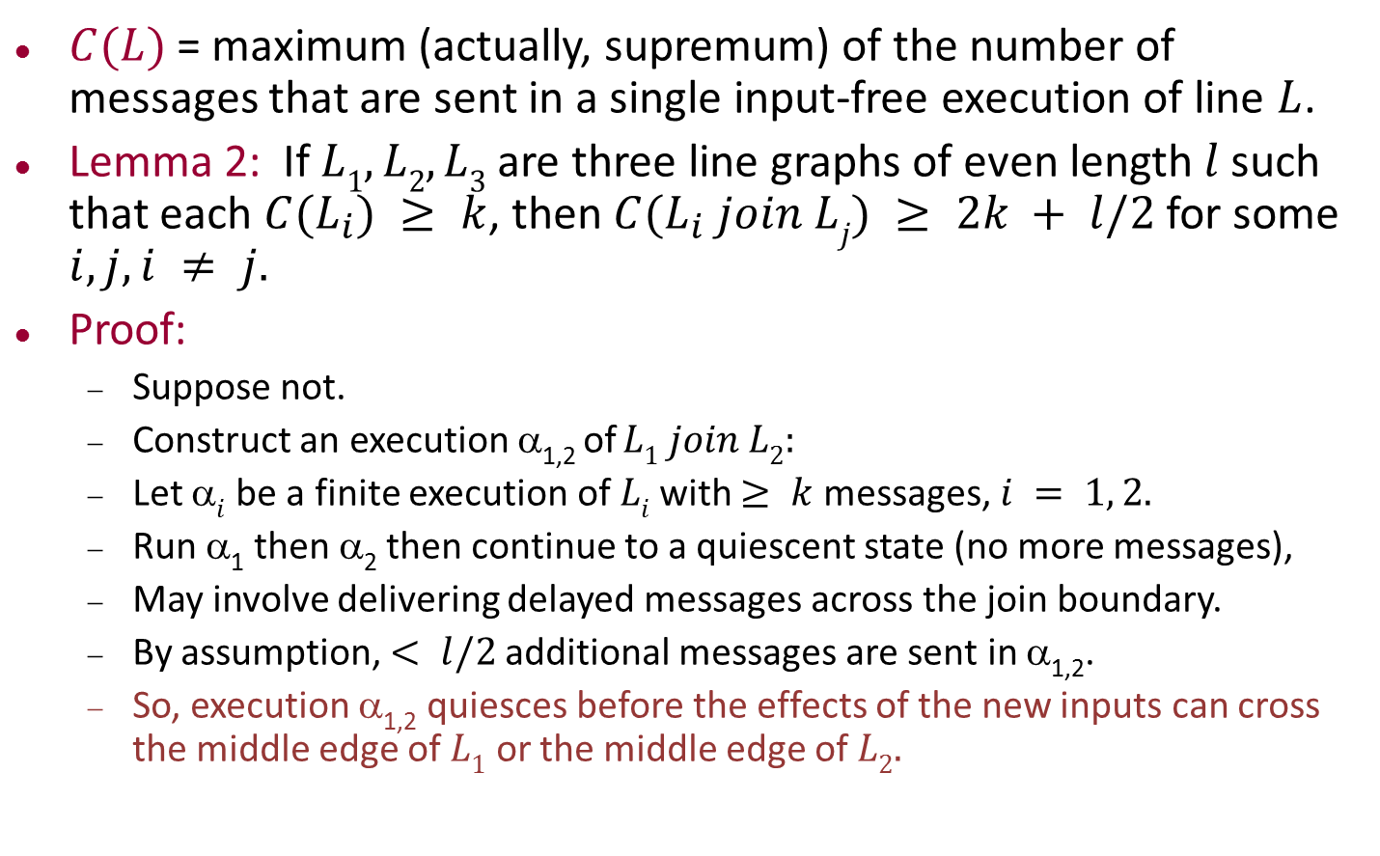

$(n log⁡n)$lower bound
$C(L)$ = maximum (actually, supremum) of the number of messages that are sent in a single input-free execution of line $L$.
Lemma 2: If $L1, L2, L3$are three line graphs of even length $l$ such that each $C(L_{i}) ≥ k$, then $C(L_{i} join Lj) ≥ 2k + l/2$for some $i, j, i ≠ j.$
Proof:
Suppose not.
Construct an execution α_{1,2} of $L1 join L2:$
Let α$i$ be a finite execution of $Li$with $≥ k$ messages, $i = 1, 2.$
Run α₁ then α₂ then continue to a quiescent state (no more messages),
May involve delivering delayed messages across the join boundary.
By assumption, $< l/2$additional messages are sent in α_{1,2}.
So, execution α_{1,2} quiesces before the effects of the new inputs can cross the middle edge of $L1$ or the middle edge of $L2.$
L₁
L₂

Slide 56
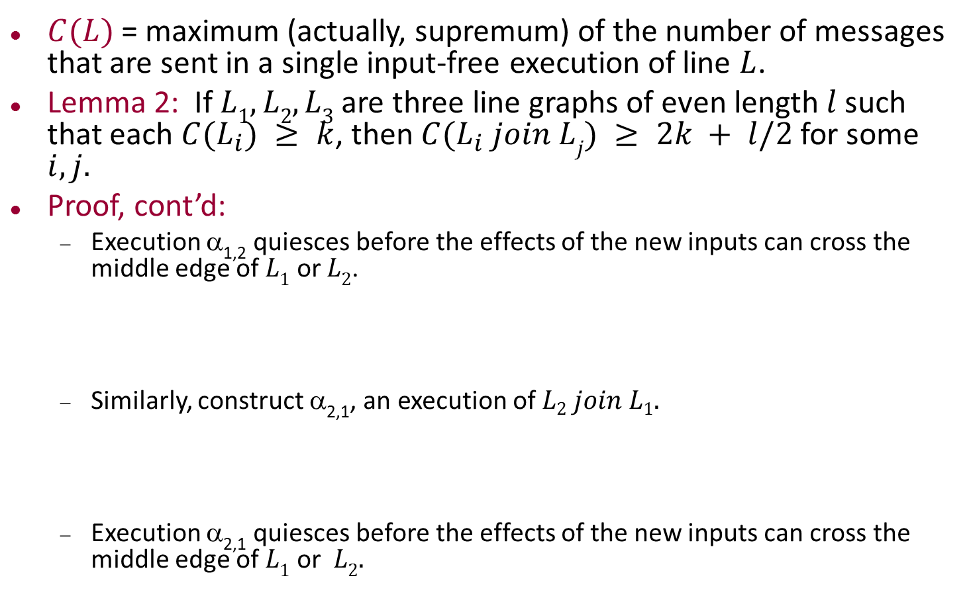
$(n log⁡n)$lower bound
$C(L)$ = maximum (actually, supremum) of the number of messages that are sent in a single input-free execution of line $L$.
Lemma 2: If $L1, L2, L3$are three line graphs of even length $l$ such that each $C(L_{i}) ≥ k$, then $C(L_{i} join Lj) ≥ 2k + l/2$for some $i, j.$
Proof, cont’d:
Execution α_{1,2} quiesces before the effects of the new inputs can cross the middle edge of $L1$ or $L2$.
Similarly, construct α_{2,1}, an execution of $L2 join L1.$
Execution α_{2,1} quiesces before the effects of the new inputs can cross the middle edge of $L1$ or $L2.$
L₁
L₂
L₂
L₁
Notes:
And we can do this for the other combinations of lines.

Slide 57
Proof of Lemma 2
Now consider three rings:
L₁
L₂
L₁
L₃
L₂
L₃

Slide 58
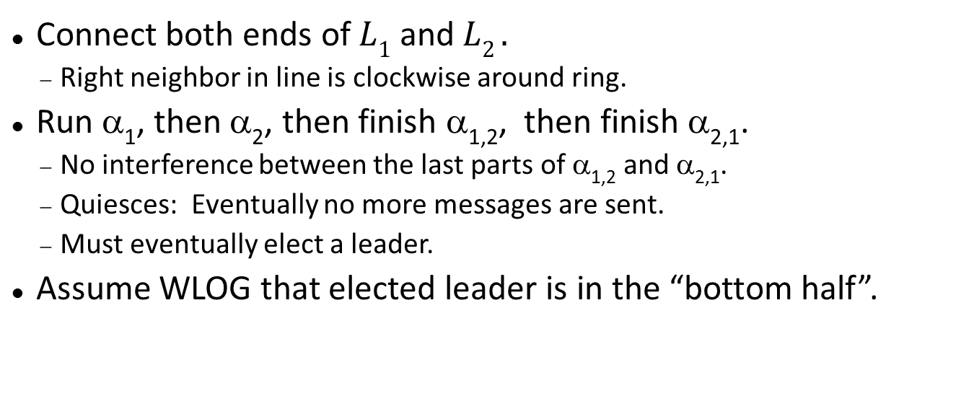
Proof of Lemma 2
L₁
L₂
Connect both ends of $L1$ and $L2 .$
Right neighbor in line is clockwise around ring.
Run α₁, then α₂, then finish α_{1,2}, then finish α_{2,1}.
No interference between the last parts of α_{1,2} and α_{2,1}.
Quiesces: Eventually no more messages are sent.
Must eventually elect a leader.
Assume WLOG that elected leader is in the “bottom half”.
Notes:
So it’s like we’re looking at the line from the inside of the ring, reading left-to-right as we are reading clockwise.

Slide 59
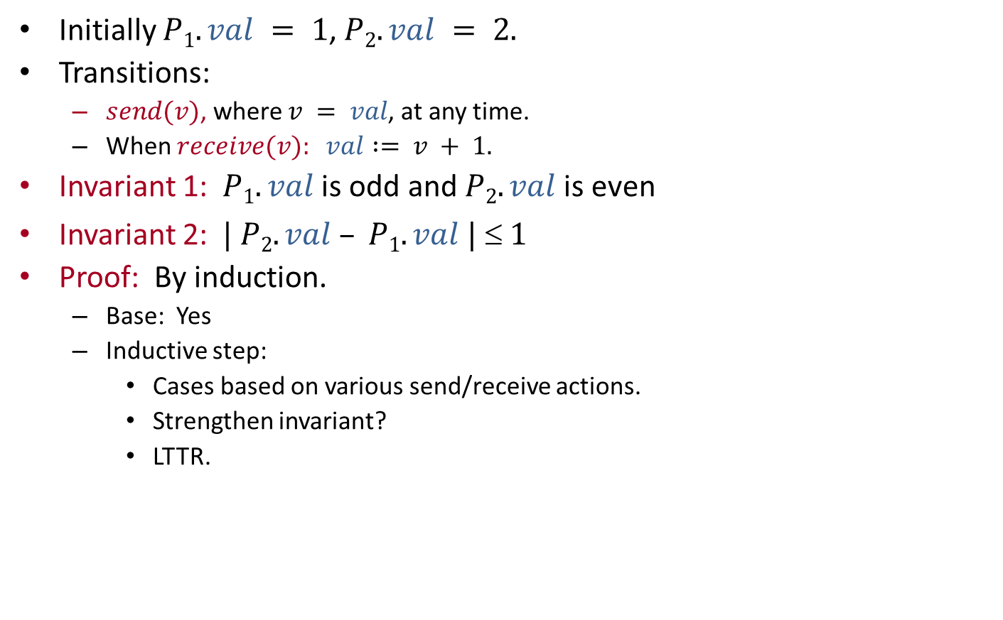
Proof of Lemma 2
L₁
L₃
L₁
L₂
L₂
L₃
L₂
Same argument for ring constructed from $L2$ and $L3.$
Can the leader be in the bottom half?
No!
So it must be in top half.
L₂
L₃

Slide 60
Proof of Lemma 2
L₁
L₂
L₂
L₃

Slide 61
Proof of Lemma 2
L₁
L₃
L₁
L₂
L₁
L₃
L₂
L₁
L₂
L₂
L₃
L₁
L₃
L₃
Notes:
But now what about L1 and L3? Is the leader in the ring formed from these two in the top half or the bottom half?
Either way, we get a contradiction.

Slide 62
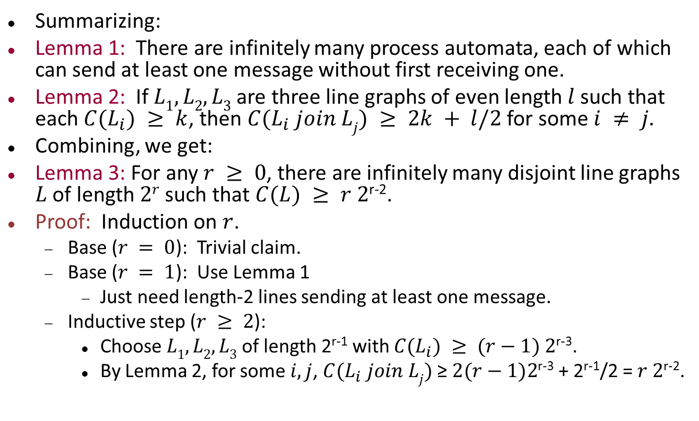
Lower bound, cont’d
Summarizing:
Lemma 1: There are infinitely many process automata, each of which can send at least one message without first receiving one.
Lemma 2: If $L1, L2, L3$are three line graphs of even length $l$ such that each $C(L_{i}) ≥ k$, then $C(L_{i} join Lj) ≥ 2k + l/2$for some $i ≠ j.$
Combining, we get:
Lemma 3: For any $r ≥ 0$, there are infinitely many disjoint line graphs $L$ of length $2r$ such that $C(L) ≥ r 2$^{r-2}.
Proof: Induction on $r$.
Base ($r = 0$): Trivial claim.
Base ($r = 1$): Use Lemma 1
Just need length-2 lines sending at least one message.
Inductive step ($r ≥ 2$):
Choose $L1, L2, L3$of length 2^{r-1} with $C(L_{i}) ≥ (r−1) 2$^{r-3}.
By Lemma 2, for some $i,j$, $C(L_{i} join Lj)$≥ $2(r−1)2$^{r-3} + 2^{r-1}/2 = $r 2$^{r-2}.

Slide 63
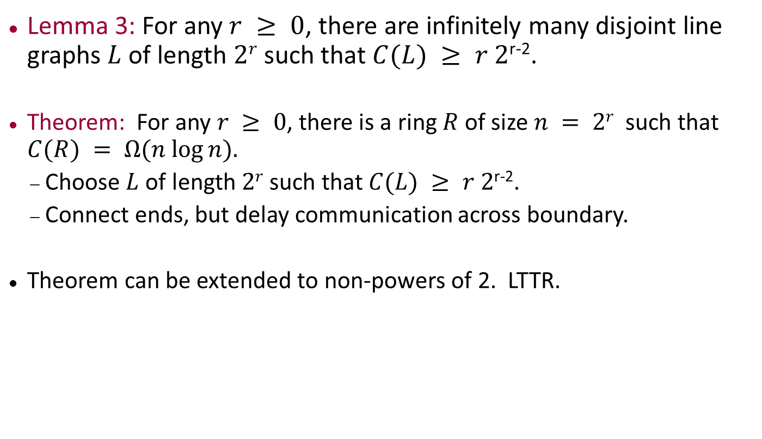
Lower bound, cont’d
Lemma 3: For any $r ≥ 0$, there are infinitely many disjoint line graphs $L$ of length $2r$ such that $C(L) ≥ r 2$^{r-2}.
Theorem: For any $r ≥ 0$, there is a ring $R$of size $n = 2r$such that $C(R) = Ω(n log⁡n).$
Choose $L$of length $2r$ such that $C(L) ≥ r 2$^{r-2}.
Connect ends, but delay communication across boundary.
Theorem can be extended to non-powers of 2. LTTR.

Slide 64
Leader Election in General Networks

Slide 65
Leader election in general networks
Consider undirected graphs.
We can get an asynchronous version of the synchronous $FloodMax$ algorithm:
Simulate rounds with local counters.
Need to know the diameter for termination.
We’ll see several better asynchronous algorithms later:
Don’t need to know diameter.
Lower message complexity.
Depend on techniques such as:
Breadth-first search
Convergecast using a spanning tree
Synchronizers to simulate synchronous algorithms
Consistent global snapshots to detect termination

Slide 66
Spanning Trees and Searching

Slide 67
Spanning trees and searching
Spanning trees are used for communication, e.g., bcast/ccast
Start with the simple task of setting up some (arbitrary) spanning tree with a (given) root $i0$.
Assume:
Undirected, connected graph (i.e., bidirectional communication).
Root $i0$
Size and diameter unknown.
UIDs, with comparisons for equality.
Can identify in- and out-edges to same neighbor.
Require: Each process should output its parent in tree, with a $parent$ output action.
Starting point: $SynchBFS$ algorithm:
$i0$ floods a $search$ message; parent of a node is the first node from which it receives a $search$ message.
Q: What if we try to run the same algorithm in an asynchronous network?
Still yields a spanning tree, but not necessarily a breadth-first tree.

Slide 68
$AsynchSpanningTree$, Process $i$
Signature
in receive(search)_{j,i}, j ∈ nbrs
out send(search)_{i,j}, j ∈ nbrs
out parent(j)_{i}, j ∈ nbrs
State
parent: nbrs U { ⊥ }, init ⊥
reported: Boolean, init false
for each j ∈ nbrs:
send(j) ∈ {search, ⊥}, init search if i = i₀, else ⊥
send(search)_{i,j} pre: send(j) = search eff: send(j) := ⊥
receive(search)_{j,i} eff: if i ≠ i₀ and parent = ⊥ then parent := j for k ∈ nbrs - { j } do send(k) := search
parent(j)_{i} pre: parent = j reported = false eff: reported := true
Notes:
Notice that the process ignores an incoming message if it already has its parent determined.

Slide 69
AsynchSpanningTree
Notes:
The black dots represent the search messages in local send buffers.

Slide 70
AsynchSpanningTree
s
Notes:
Send a message.

Slide 71
AsynchSpanningTree
s
s
Notes:
Send another message.

Slide 72
AsynchSpanningTree
s
Notes:
Arrival of a message at the middle node, producing three messages in its send buffers and also setting the parent pointer for the recipient node (reverse the arrow in the diagram).

Slide 73
AsynchSpanningTree
s
Notes:
This shows the result of two more steps:
Arrival of one message at the “valley” node, causing two messages to be placed in its send buffers and causing its parent pointer to be set, and
Sending of a message by the middle node.

Slide 74
AsynchSpanningTree
s
s
Notes:
And several more steps. The “middle” node sends a message from its buffer.
Then the valley node sends a message, which gets relayed to the rightmost node.
Two parent pointers are set.

Slide 75
AsynchSpanningTree
s
Notes:
Now the two rightmost messages in send buffers are sent and then arrive at the bottom node, with the rightmost arriving first. From there a message is sent to the lower left node, resulting in two messages in its local buffers.

Slide 76
AsynchSpanningTree
s
s
s
Notes:
Now a message arrives from the middle node to the lower left, with no effect, since the node already has a parent.
Then three more messages in buffers are sent.

Slide 77
AsynchSpanningTree
Notes:
The message to the left node arrives, setting the parent pointer.
The other messages arrive, having no effect.
The final message from the root is sent and arrives, with no effect.
So this shows the final spanning tree.
It’s not breadth-first, obviously.

Slide 78
AsynchSpanningTree
Complexity
Messages: $O( |E| )$
Time: $diam (l+d) + l$
Anomaly: Paths may be longer than the diameter!
Messages may travel faster along longer paths, in asynchronous networks.

Slide 79
Applications of AsynchSpanningTree
Similar to synchronous BFS
Message broadcast: Piggyback on $search$ message.
Child pointers: Add responses to $search$ messages, easy because of bidirectional communication.
Use precomputed tree for bcast/convergecast
Now the timing anomaly becomes significant.
$O( h(l+d) )$time complexity.
$O(|E|)$message complexity.
See book for details.
$h$ = height of tree; may be as large as n

Slide 80
More applications
Asynchronous broadcast/convergecast:
Can also construct spanning tree while using it to broadcast message and also to collect responses.
E.g., to tell the root when the bcast is done, or to collect aggregated data.
See book, p. 499-500, $AsynchBcastAck.$
Complexity:
$O(|E|)$message complexity.
$O( n (l+d) )$time complexity, timing anomaly.
See book for details.
Elect leader when nodes have no info about the network (no knowledge of $n, diam,$etc.; no root, no spanning tree):
All independently initiate $AsynchBcastAck$, use it to determine max, max elects itself.

Slide 81
Next lecture
More asynchronous network algorithms
Breadth-first search
Shortest paths
Minimum spanning tree (GHS)
Readings:
Sections 15.3-15.5
[Gallager, Humblet, Spira]

